Slide 1
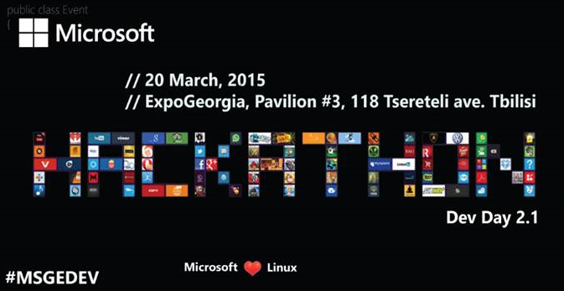

Slide 2
Agenda:
ASP.NET 5 (Karen Tazayan, MVP)
Azure + Web-sites (Alexey Bokov, Azure PM )
Internet of Things (Konstantin Goldstein, Senior PM )
BizSpark (Levon Hovhannisyan, Microsoft evangelist )
Hackaton – hands-on practice
Code review with pizza (~5-6PM)
Notes:
1,000 new customers per day
1,000,000 cores milestone achieved September last year
1.6 Hexabyte milestones achieved at the end of last year

Slide 3
Goals :
Help you to learn Azure technologies by real experience, no bull-shit slides!
Contribute to open source, please deploy all code to github, codeplex, etc
Finalize your apps after hackaton, share your experience with community and open source your app/framework/scripts
Notes:
1,000 new customers per day
1,000,000 cores milestone achieved September last year
1.6 Hexabyte milestones achieved at the end of last year

Slide 4
How hackaton works!?
Attend session ☺
Choose topic which you live/love more
Join (if you want) other folks in that topic – make a team!
Start coding – choose any task which you want from selected topic or do your own
Use #msgedev
Commit to github for your code/scripts/etc
Ask questions
Enjoy your time – do code and have fun!
Notes:
1,000 new customers per day
1,000,000 cores milestone achieved September last year
1.6 Hexabyte milestones achieved at the end of last year

